Slide 1
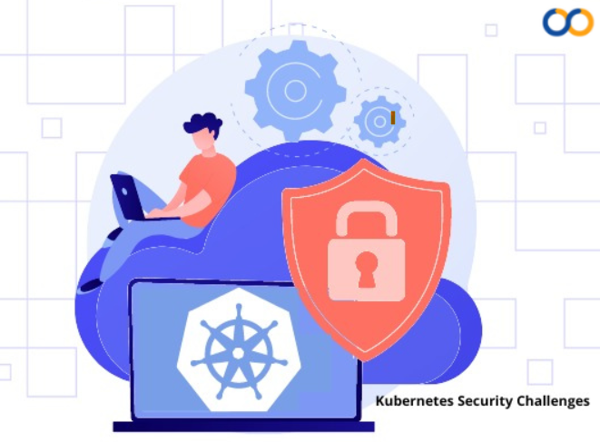
Kubernetes Hardening via Building STIG/CIS-compliant AMIs for Amazon EKS
Ilia Eriomenco
DevOps Engineer at Endava

Slide 2
Agenda
Introduction in hardening
Standards (CIS, DISA STIGs, NIST, SCAP) and tools for AMI hardening
AMI hardening steps: preparation, scanner reports, implementation
Extra hardening EKS AMI (FIPS 140-2, Kubelet)
OpenSCAP alternatives
Different way to harden AMI
Next hardening steps

Slide 3

Why do we need to harden Kubernetes cluster?
Through Kubernetes has several built-in security advantages for example, container images are usually replaced, not patched or updated, which leads to better version control its increase in use means more opportunity for exposure. Because Kubernetes is a relatively new and complex technology, it is also highly attractive to hackers. Many organizations also need to harden the operating system on the worker nodes for security and compliance purposes.

Slide 4
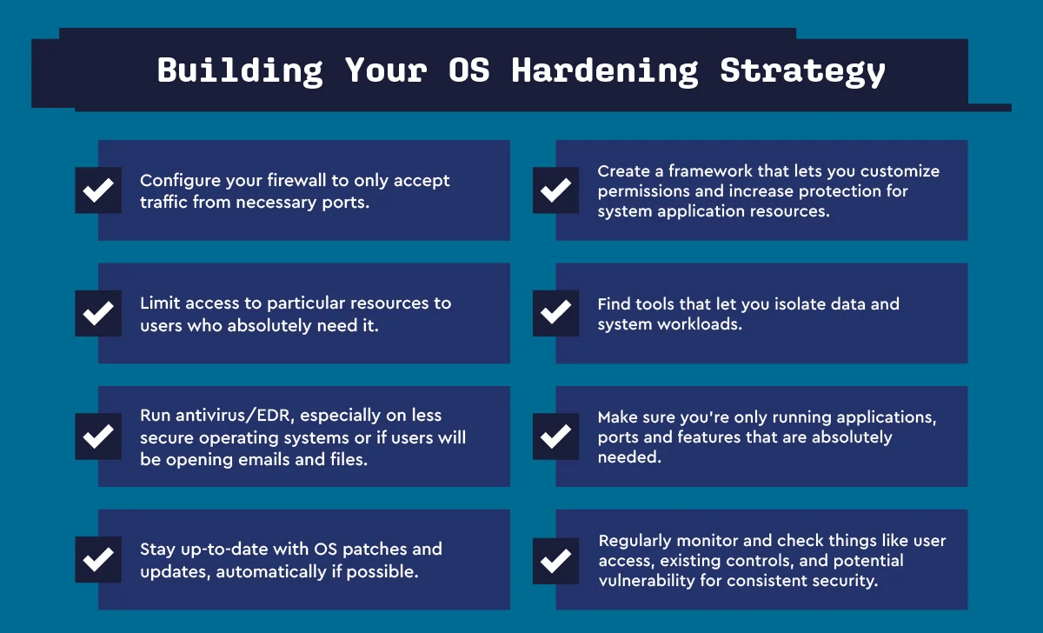
Operating System Hardening

Slide 5

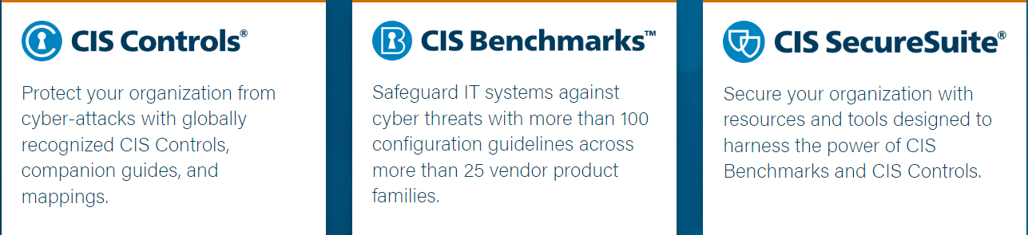

Slide 6

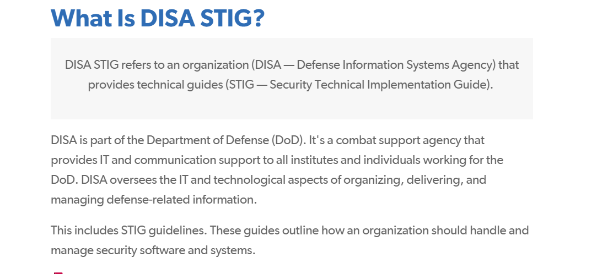

Slide 7
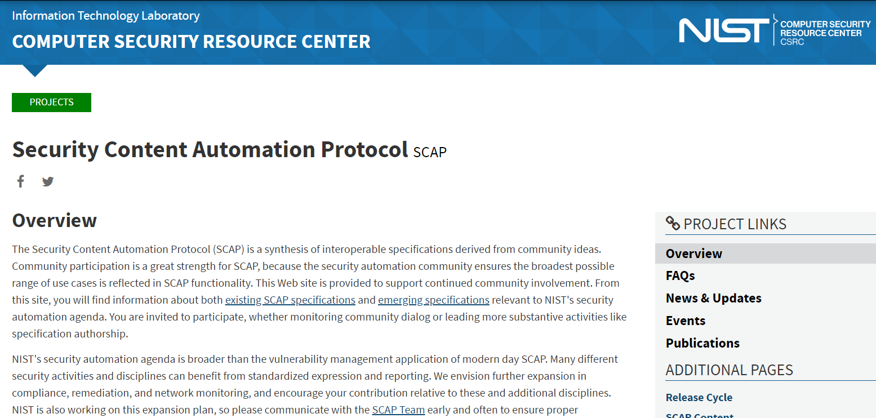
SCAP

Slide 8
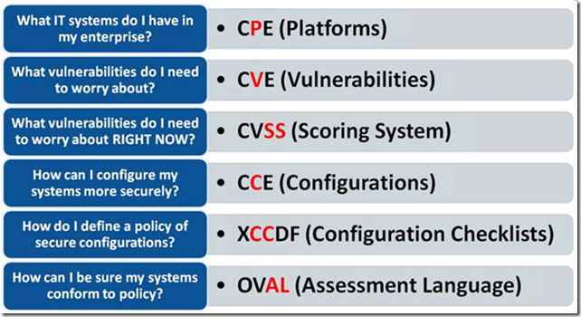
SCAP components

Slide 9

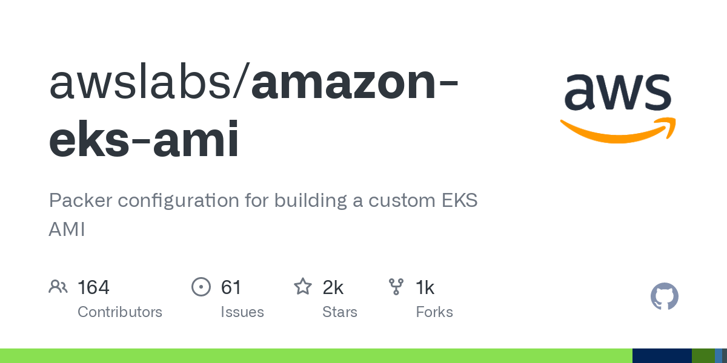

Hardening tools and technologies
AuditD
OpenSCAP - Open Source Security Compliance Solution for scanning and reporting by NIST/CIS/DISA standards AuditD - is a native tool designed for monitoring operating system events and recording them in event logs, developed and supported by RedHat.
Amazon EKS AMI Builder - Resources and configuration scripts for building a custom Amazon EKS AMI with HashiCorp Packer.

Slide 10
EKS AMI Builder preparations (way 1)
Clone/fork repository from https://github.com/awslabs/amazon-eks-ami
Update the default AWS region in eks-worker-al2-variables.json: "aws_region": "us-west-2", "binary_bucket_region": "us-west-2", => "aws_region": “<your_region>", "binary_bucket_region": "“<your_region>",
Update ami_name in Makefile (add postfix –secured or -hardened)
Prepare your AWS credentials and add them in Github secrets
Delete vendor’s pipelines and create your custom pipeline

Slide 11
Create GitHub Actions pipeline (way 1)
on:
workflow_dispatch:
env:
AWS_ACCESS_KEY_ID: ${{ secrets.AWS_ACCESS_KEY}}
AWS_SECRET_ACCESS_KEY: ${{ secrets.AWS_SECRET_ACCESS_KEY}}
jobs:
ami-build:
runs-on: ubuntu-latest
continue-on-error: false
steps:
- uses: actions/checkout@v3
- uses: hashicorp/setup-packer@main
with:
packer_version: latest
- name: EKS AMI build
run: |
make

Slide 12
EKS AMI Builder preparations (way 2)
Create your own Github repository
Prepare your AWS credentials and add them in Github secrets
Delete vendor’s pipelines and create more parameterized Github Actions pipeline:
on:
workflow_dispatch:
inputs:
build_id:
description: 'Get value from AMI Details (AMI names) from awslabs/amazon-eks-ami/releases’ repo
required: true
type: string
default: 'v20231114'
kubernetes_build_date:
description: 'Get value from AMI Details (Release version) from awslabs/amazon-eks-ami/releases'
required: true
type: string
default: '2023-11-02'
k8s_version:
description: 'Get value from AMI Details (AMI names) from awslabs/amazon-eks-ami/releases’ repo
required: true
type: string
default: '1.28'

Slide 13
Github Actions pipeline (way 2)
k8s_patch_version:
description: 'Get value from AMI Details (Release version) from awslabs/amazon-eks-ami/releases'
required: true
type: string
default: '3'
additional_arguments:
description: ''
required: false
type: string
env:
AWS_ACCESS_KEY_ID: ${{ secrets.AWS_ACCESS_KEY_ID}}
AWS_SECRET_ACCESS_KEY: ${{ secrets.AWS_SECRET_ACCESS_KEY}}
jobs:
ami-build:
runs-on: ubuntu-latest
continue-on-error: false
steps:
- uses: AutoModality/action-clean@v1
- uses: actions/checkout@v4
with:
repository: 'awslabs/amazon-eks-ami.git'

Slide 14
Github Actions pipeline (way 2)
k8s_patch_version:
description: 'Get value from AMI Details (Release version) in https://github.com/awslabs/amazon-eks-ami/releases'
required: true
type: string
default: '3' env:
AWS_ACCESS_KEY_ID: ${{ secrets.AWS_ACCESS_KEY_ID}}
AWS_SECRET_ACCESS_KEY: ${{ secrets.AWS_SECRET_ACCESS_KEY}}
jobs:
ami-build:
runs-on: ubuntu-latest
continue-on-error: false
steps:
- uses: AutoModality/action-clean@v1
- uses: actions/checkout@v4
with:
repository: 'awslabs/amazon-eks-ami.git’
ref: 'master'
- uses: hashicorp/setup-packer@main
with:
packer_version: latest

Slide 15
Github Actions pipeline (way 2)
- id: build
name: EKS AMI build
shell: bash
run: |
sed -i 's/us-west-2/eu-west-2/g' ./eks-worker-al2-variables.json
sed -i 's/\"enable_fips\": \"false\"/\"enable_fips\": \"true\"/g' ./eks-worker-al2-variables.json
sed -i 's/\"kubernetes_build_date\": null/\"kubernetes_build_date\": \"${{ inputs.kubernetes_build_date }}\"/g' ./eks-worker-al2.json
sed -i 's/\"kubernetes_version\": null/\"kubernetes_version\": \"${{ inputs.k8s_version }}.${{ inputs.k8s_patch_version }}\"/g' ./eks-worker-al2.json
AMI_NAME="hardened-amazon-eks-node-${{ inputs.k8s_version }}-${{ inputs.build_id }}"
cat << 'EOF' > ./scripts/upgrade_kernel.sh
<your hardening bash commands>
EOF cat << 'EOF' > ./files/kubelet-containerd.service <your hardening kubelet unit file content>
EOF
make ${{ inputs.k8s_version }} ami_name=${AMI_NAME}

Slide 16
Initial OpenSCAP report before hardening
# Create EC2 instance from optimized EKS AMI
# Install OpenSCAP
sudo amazon-linux-extras install epel –y sudo yum update -y sudo yum install openscap-scanner scap-security-guide –y
# Scanning OS with OpenSCAP sudo oscap xccdf eval --profile xccdf_org.ssgproject.content_profile_ospp \
--report /tmp/initial_report.html\ /usr/share/xml/scap/ssg/content/ssg-amzn2-ds.xml

Slide 17
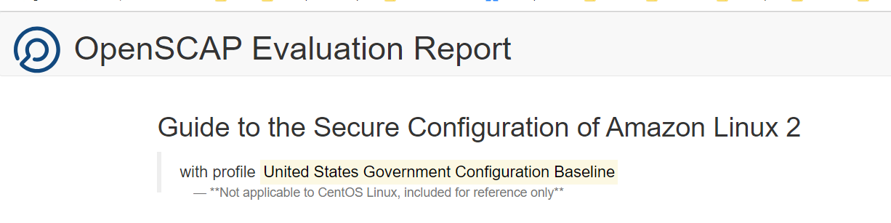
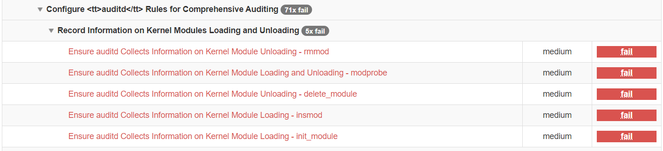
Initial report fragment

Slide 18
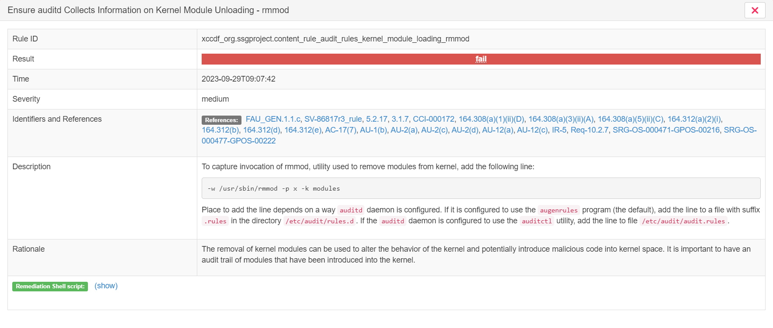
Kernel Module Unloading - rmmod

Slide 19
Manual rmmod, modprobe, insmod hardering
sudo bash -c 'cat > /etc/audit/rules.d/extra-audit.rules <<EOF
-w /usr/sbin/rmmod -p x -k modules
-w /usr/sbin/modprobe -p x -k modules
-a always,exit -F arch=b32 -S delete_module -F key=modules
-a always,exit -F arch=b64 -S delete_module -F key=modules
-w /usr/sbin/insmod -p x -k modules -a always,exit -F arch=b32 -S init_module -F key=modules
-a always,exit -F arch=b64 -S init_module -F key=modules EOF’
sudo auditctl -D
sudo auditctl -R /etc/audit/rules.d/extra-audit.rules
sudo service auditd restart sudo oscap xccdf eval --profile xccdf_org.ssgproject.content_profile_ospp --report /tmp/initial_report.html\ /usr/share/xml/scap/ssg/content/ssg-amzn2-ds.xml
AuditD

Slide 20
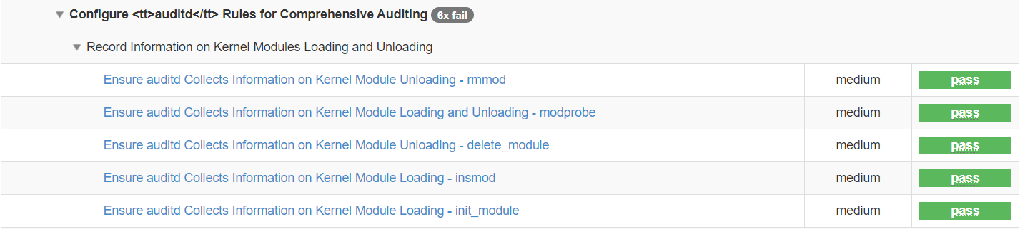
Report fragment after hardening

Slide 21
Automation rmmod, modprobe, insmod hardering
# Auditd configuration
sudo bash -c ‘cat > /etc/audit/rules.d/extra-audit.rules <<EOF
-w /usr/sbin/rmmod -p x -k modules
-w /usr/sbin/modprobe -p x -k modules
-a always,exit -F arch=b32 -S delete_module -F key=modules
-a always,exit -F arch=b64 -S delete_module -F key=modules
-w /usr/sbin/insmod -p x -k modules -a always,exit -F arch=b32 -S init_module -F key=modules
-a always,exit -F arch=b64 -S init_module -F key=modules EOF’ sudo service auditd restart
AuditD
in github.com/awslabs/amazon-eks-ami/blob/master/scripts/upgrade_kernel.sh

Slide 22
Lazy way - hardening over Auditd rules templates
# Auditd configuration
sudo mkdir -p /usr/share/doc/audit/rules
sudo wget -O /usr/share/doc/audit/rules/30-stig.rules https://raw.githubusercontent.com/linux-audit/audit-userspace/master/rules/30-stig.rules sudo auditctl -R /usr/share/doc/audit/rules/30-stig.rules sudo cp /usr/share/doc/audit/rules/30-stig.rules /etc/audit/rules.d/ sudo service auditd restart
AuditD
Rules templates storage - https://github.com/linux-audit/audit-userspace/blob/master/rules/

Slide 23
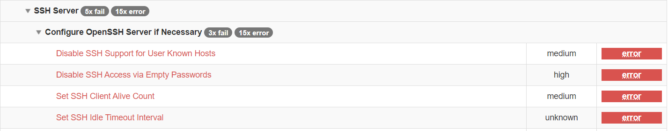
Report before OpenSSH Server hardening

Slide 24
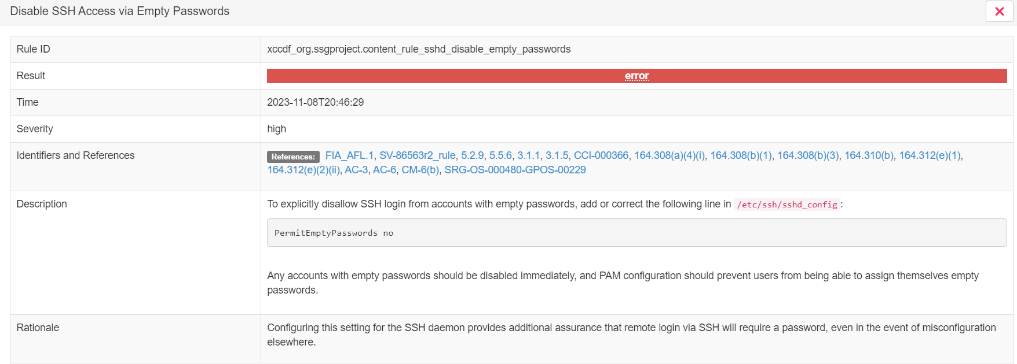
Disable SSH Access via Empty Passwords

Slide 25

Hardening OpenSSH Server
#!/bin/bash
sudo sed -i 's/#IgnoreUserKnownHosts no/IgnoreUserKnownHosts yes/g' /etc/ssh/sshd_config
sudo sed -i 's/#PermitEmptyPasswords no/PermitEmptyPasswords no/g' /etc/ssh/sshd_config
sudo sed -i 's/#ClientAliveCountMax 3/ClientAliveCountMax 0/g' /etc/ssh/sshd_config
sudo sed -i 's/ClientAliveCountMax 600/ClientAliveInterval 600/g' /etc/ssh/sshd_config sudo systemctl restart sshd # OpenSCAP scanning after hardening sudo oscap xccdf eval --profile xccdf_org.ssgproject.content_profile_ospp --report /home/ec2-user/oscap_report_after.html /usr/share/xml/scap/ssg/content/ssg-amzn2-ds.xml

Slide 26
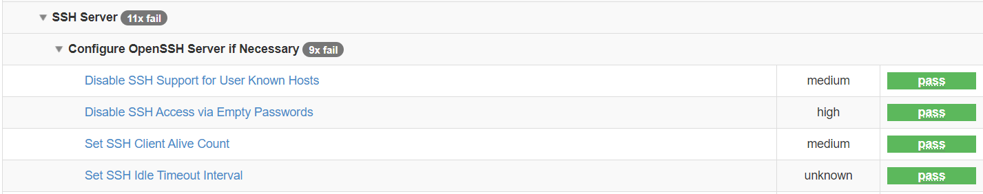
Report after OpenSSH Server hardening

Slide 27
Hardening EKS AMI - Enabling FIPS-140
Update kernel updating code in scripts/upgrade_kernel.sh from default:
sudo yum install -y kernel-headers kernel-devel
# enable pressure stall information
sudo grubby \
--update-kernel=ALL \
--args="psi=1"
to custom:
sudo yum install -y kernel-headers kernel-devel dracut-fips
# enable the FIPS module
sudo dracut -f
# enable pressure stall information
sudo grubby \
--update-kernel=ALL \
--args="psi=1" \
--args="fips=1"

Slide 28
Hardening EKS AMI - Kubelet
Add in default kubelet unit file (files/kubelet-containerd.service):
ExecStart=/usr/bin/kubelet \
--config /etc/kubernetes/kubelet/kubelet-config.json \
--kubeconfig /var/lib/kubelet/kubeconfig \
--container-runtime-endpoint unix:///run/containerd/containerd.sock \
--image-credential-provider-config /etc/eks/image-credential-provider/config.json \
--image-credential-provider-bin-dir /etc/eks/image-credential-provider \
$KUBELET_ARGS \
$KUBELET_EXTRA_ARGS
custom section:
$KUBELET_ARGS \
$KUBELET_EXTRA_ARGS \
--anonymous-auth=false \
--authorization-mode=Webhook \
--client-ca-file=/etc/kubernetes/pki/ca.crt \
--make-iptables-util-chains=true

Slide 29
Hardening EKS AMI – Kubelet (config)
Also you can configure Kubelet through changing files/kubelet-config.json:
"authentication": {
"anonymous": {
"enabled": false
}, … "x509": {
"clientCAFile": "/etc/kubernetes/pki/ca.crt"
} … "authorization": {
"mode": "Webhook", … "featureGates": {
"RotateKubeletServerCertificate": true
},
"protectKernelDefaults": true,

Slide 30


OpenScap alternatives
Lynis is a battle-tested security tool for systems running Linux,
macOS, or Unix-based operating system.
It performs an extensive health scan of your systems to support
system hardening and compliance testing.
The project is open source software with the GPL license
and available since 2007
https://github.com/CISOfy/lynis
OpenVAS is a full-featured vulnerability scanner. Its capabilities include unauthenticated and authenticated testing, various high-level and low-level internet and industrial protocols, performance tuning for large-scale scans and a powerful internal programming language to implement any type of vulnerability test. The scanner obtains the tests for detecting vulnerabilities from a feed that has a long history and daily updates.
https://github.com/greenbone/openvas-scanner

Slide 31

Bottlerocket OS
Hardening way for avoiding custom AMI hardening painful
Bottlerocket is a special-purpose OS from AWS designed for running Linux containers. Bottlerocket includes only the essential software required to run containers, thereby effectively reducing the attack surface and ensuring that the underlying software is always secure. Bottlerocket focuses on security and maintainability, providing a reliable, consistent,
and safe platform for container-based workloads.
This is a reflection of what we've learned building operating systems and services at Amazon.
The base operating system has just what you need to run containers reliably,
and is built with standard open-source components.
Bottlerocket-specific additions focus on reliable updates and on the API.
Instead of making configuration changes manually, you can change settings with an API call,
and these changes are automatically migrated through updates.

Slide 32
Bottlerocket native support in EKS node groups
# Default node group - as provided by AWS EKS using Bottlerocket
bottlerocket_default = {
# By default, the module creates a launch template to ensure tags are propagated to instances, etc.,
# so we need to disable it to use the default template provided by the AWS EKS managed node group service
use_custom_launch_template = false
ami_type = "BOTTLEROCKET_x86_64"
platform = "bottlerocket"
}
# Adds to the AWS provided user data
bottlerocket_add = {
ami_type = "BOTTLEROCKET_x86_64"
platform = "bottlerocket"
https://github.com/terraform-aws-modules/terraform-aws-eks/blob/master/examples/eks_managed_node_group/main.tf

Slide 33

What is next hardening steps?
Of course next we need to harden infrastructure and external services like (AWS case):
VPC (Remove default VPC, harden EKS VPC Security Groups)
RDS (Define non-standard ports)
S3 (SSL only, Server Side encryption with custom KMS keys)
KMS (Mandatory key rotation often then 90 days)
EC2 (Default EBS encryption with custom KMS keys, related with EKS nodes)
We used OpenSCAP for OS hardening
For infrastructure we should use AWS Security Hub
Security standards
CIS AWS Foundations Benchmark v1.2.0
CIS AWS Foundations Benchmark v1.4.0
PCI DSS v3.2.1
NIST Special Publication 800-53 Revision 5
AWS Foundational Security Best Practices v1.0.0
Remediation instructions https://docs.aws.amazon.com/securityhub/latest/userguide/securityhub-controls-reference.html

Slide 34
Resume
Why do we need to harden Kubernetes?
Operating System hardening
Hardening standards – CIS, DISA STIGs, NIST, SCAP
Hardening tools and technologies (OpenSCAP, Auditd, EKS AMI Builder)
EKS AMI Builder preparations (2 ways)
OpenSCAP report before hardening
Manual hardening “Record Information on Kernel Modules Loading and Unloading”
OpenSCAP report after hardening
Automate hardening (adding commands in scripts/upgrade_kernel.sh AMI Builder)
Lazy way - hardening through usage complete Auditd rules sets from templates
OpenSSH server hardening
Extra hardening EKS AMI - Enabling FIPS 140-2, Kubelet (unit file), Kubelet (config)
OpenSCAP alternatives (Lynis, OpenVAS)
Bottlerocket OS (different way to harden AMI)
What is next hardening steps (Infrastructure and external services)?

Slide 35
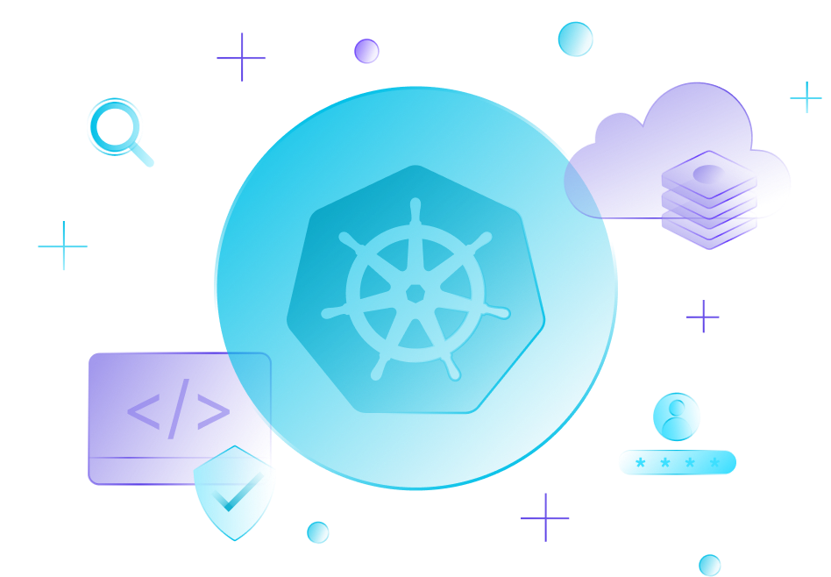
Links:
https://www.cisecurity.org/cis-benchmarks
https://public.cyber.mil/stigs https://www.open-scap.org https://csrc.nist.gov/projects/security-content-automation-protocol https://github.com/linux-audit/audit-userspace/tree/master/rules https://github.com/awslabs/amazon-eks-ami
https://github.com/CISOfy/lynis
https://github.com/greenbone/openvas-scanner
https://github.com/bottlerocket-os/bottlerocket https://docs.aws.amazon.com/securityhub

Slide 36
Thank you!

